Slide 1
From an Elevator Pitch to Box Office Success: Unlocking Cinema's Predictive Power
YashKumar Kalariya Bassam Shazli Mujtaba Nadeem

Slide 2
Can FILM PRODUCERS leverage analytics to CONFIDENTLY PREDICT A MOVIE’S SUCCESS, by analyzing controllable factors such as Genres, Budget, Runtime, MPAA Ratings, and Release Timing to forecast audience reception, critical acclaim, and blockbuster potential?
Business Question

Slide 3
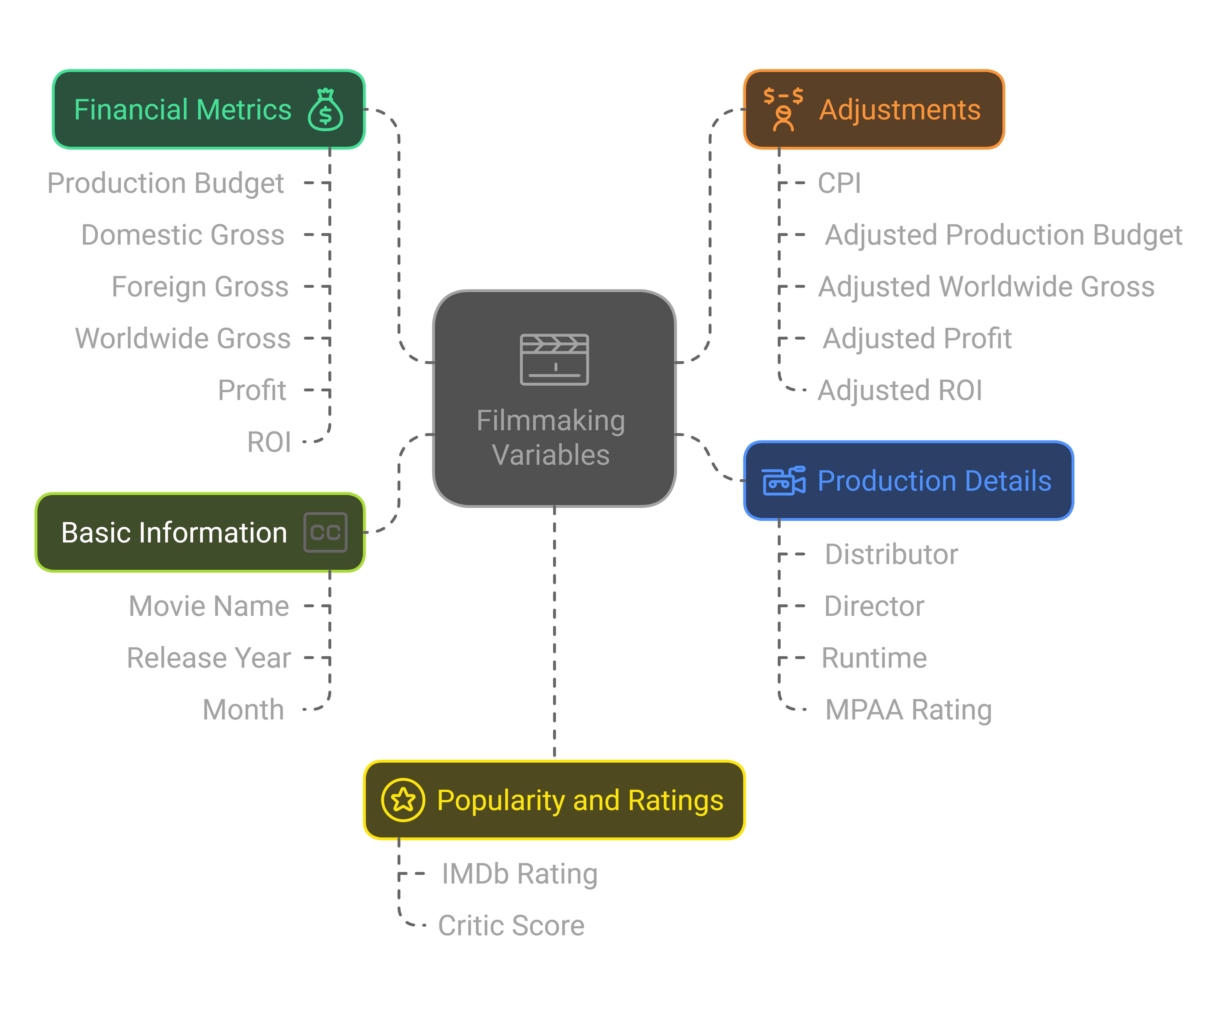
Data Understanding
Movies from 2010–2018 (1,765)
Data sources: IMDb, TMDB, Box Office Mojo, Rotten Tomatoes
Adjustments:
- Financial data adjusted for inflation.
- Streamlined focus on commercial theatrical releases.
Cleaning:
- Removal of irrelevant data: Movies not rated
- Duplicate entries.
- Movies with no revenue or unspecified
genres/ratings.
Outcome:
- A robust dataset of 1184 observations with accurate and relevant information for analysis.

Slide 4

Feature Engineering in Data Analysis

Slide 5
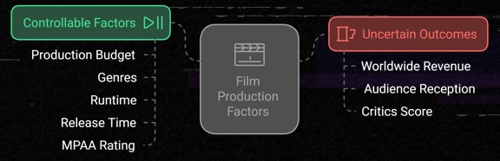
Variable selection
Dependent Variables given range
Critic Category | Range
Unpopular | <= 38
Moderate | > 38 <= 67
Popular | > 67
IMDB Category | Range
Poor | <= 6.0
Good | > 6.0 <= 7.0
Excellent | > 7.0
Gross Category | Range (Log)
Low | <= 17.19
Medium | > 17.19 <=18.46
High | > 18.46

Slide 6
Data Visualization

Slide 7
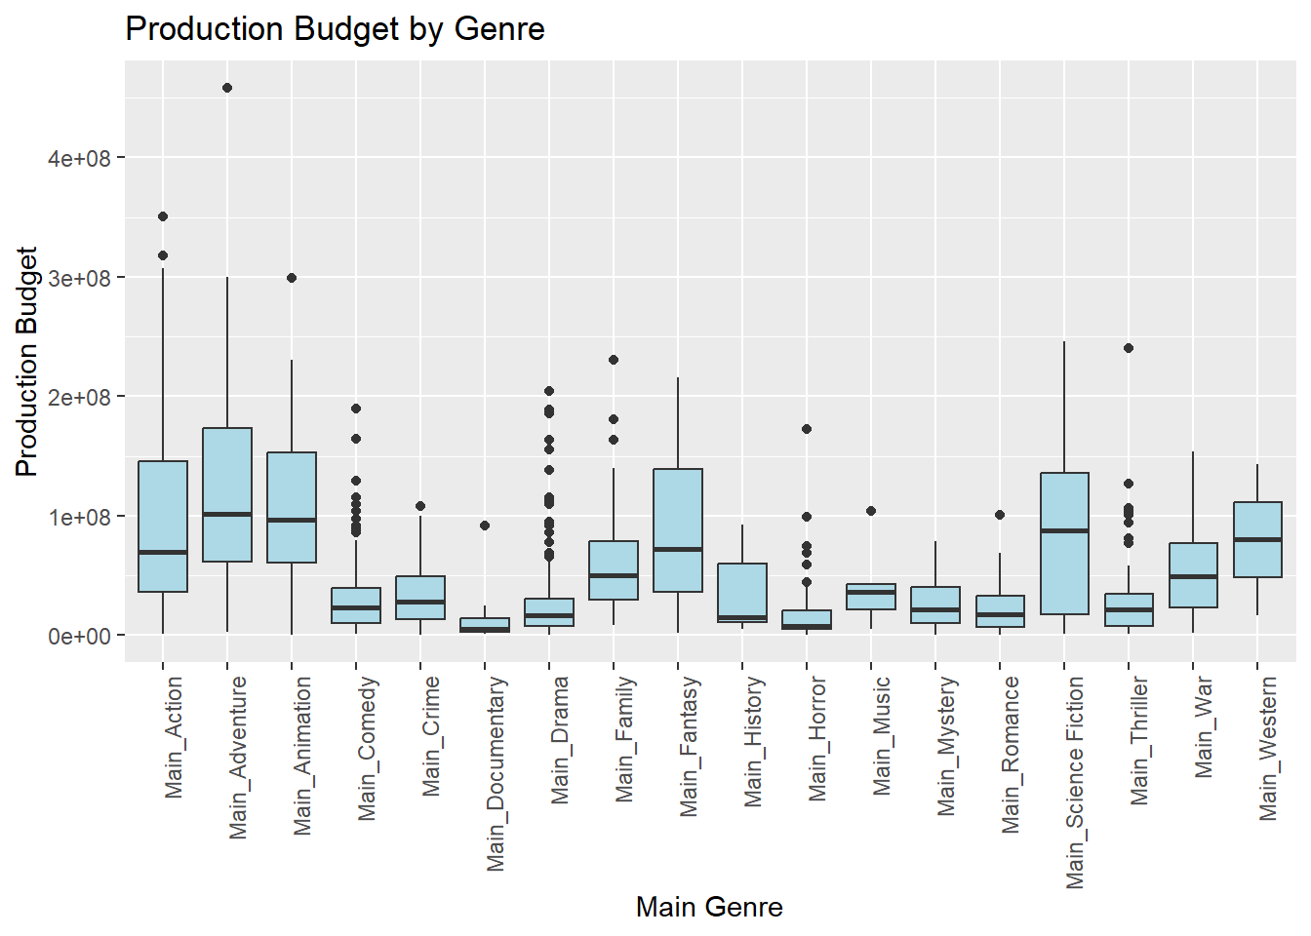
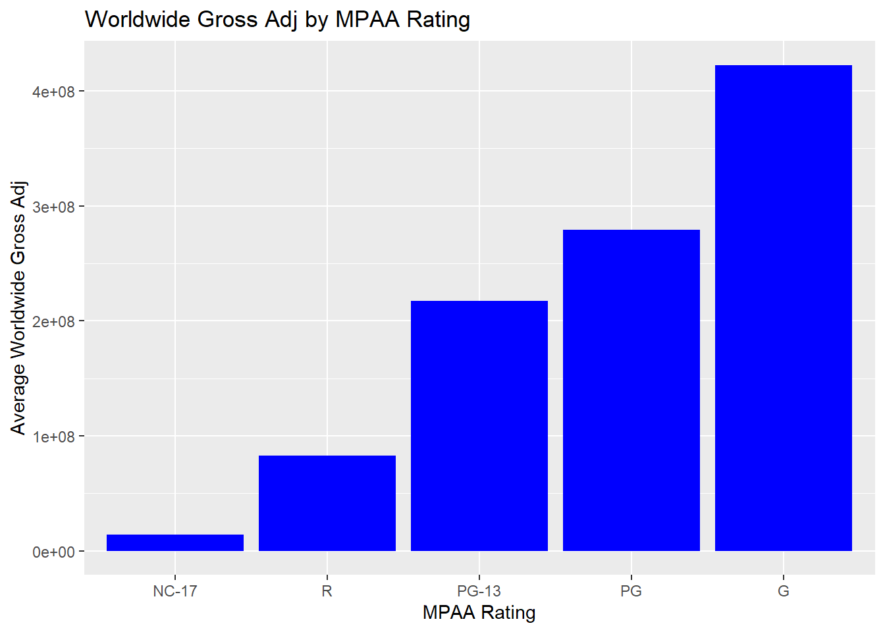
Production Budget By Genre
Worldwide Gross Adj by MPAA Rating

Slide 8
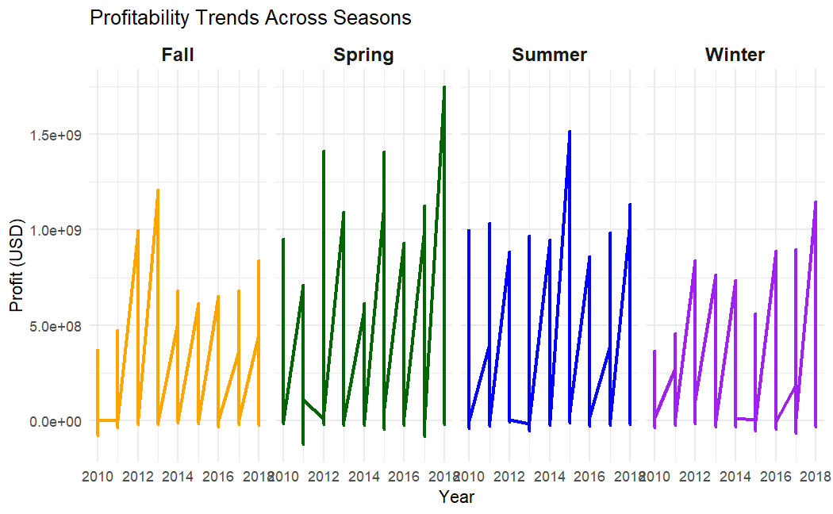
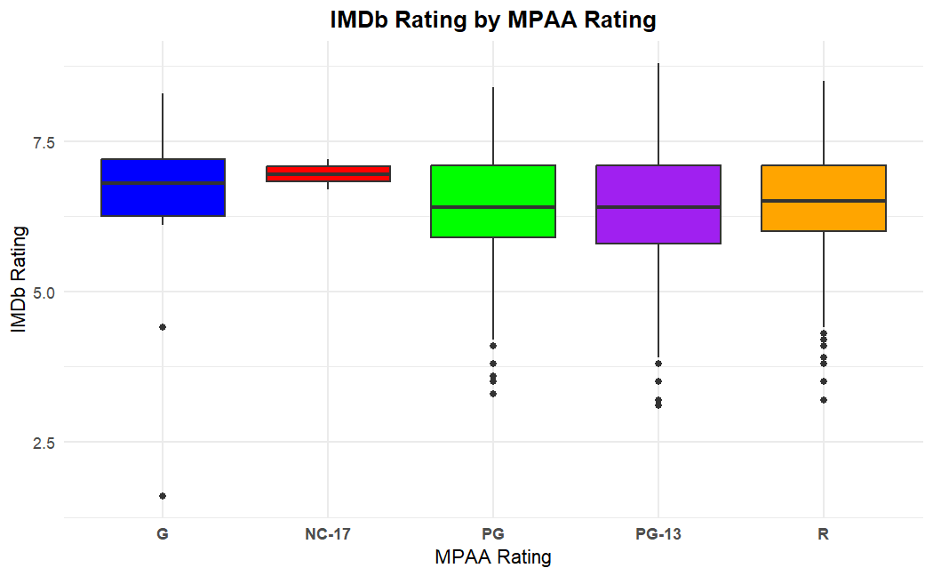
Profitability Trends Across Seasons
IMDB Rating by MPAA Rating

Slide 9
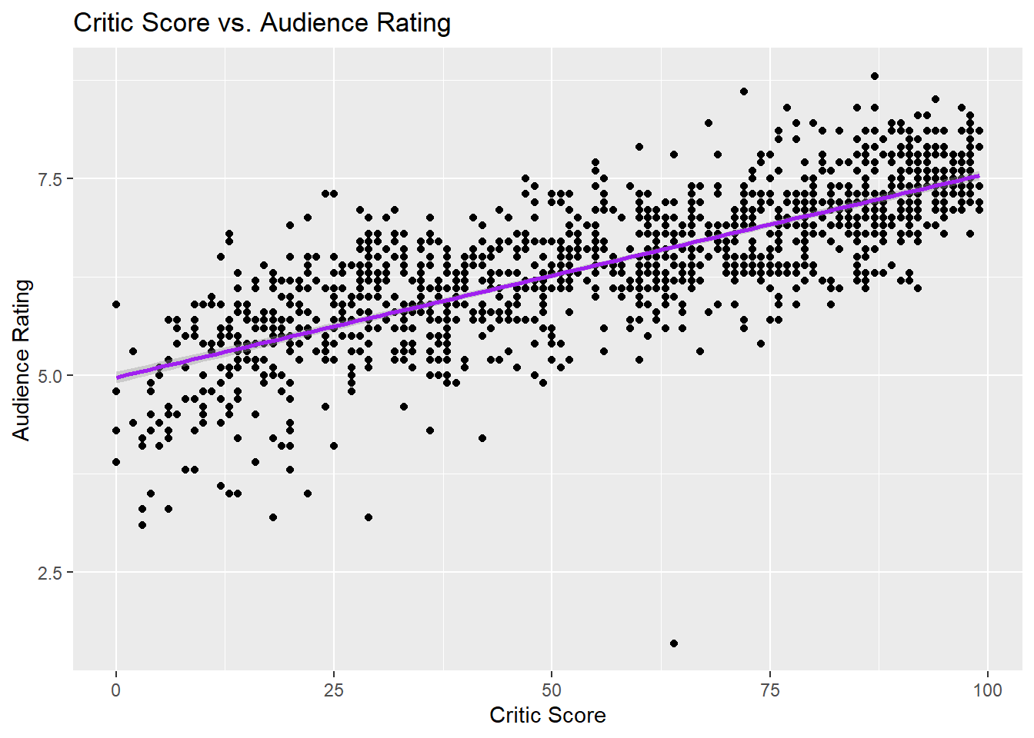
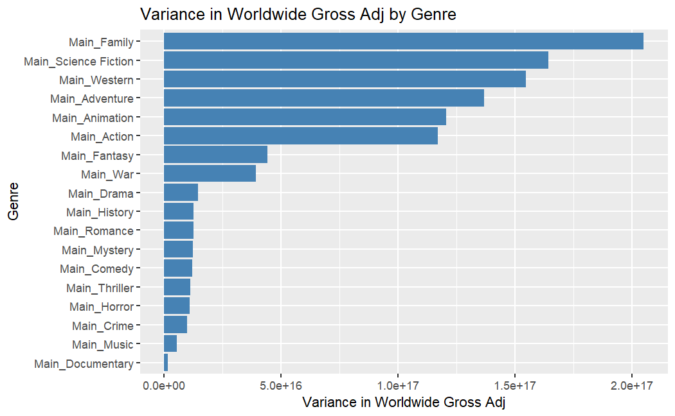
Critic Score V/s Audience Rating
Variance in Worldwide Gross Adj by Genre

Slide 10


Slide 11
Model Selection
Dependent Variable | Log_Worldwide_Gross_Category | Critic_score_category | IMDB_Category
Best Model | XGBoost | XGBoost | Random Forest
Key Predictors | - Log_production_budget_adj - genre_count - Main_Horror - Fall - R - Main_Comedy - Summer -PG.13 - Main_Action - between_90_135 | - Log_production_budget_adj - genre_count - Main_Drama - between_90_135 - PG.13 - Spring - Fall - Summer - R - Main_Comedy | - Log_production_budget_adj - genre_count - Main_Drama - between_90_135 - Greater_than_135 - Fall - R - Main_Horror - Main_Fantasy - Main_Comedy
High Performance Metrics (overall) | -Sensitivity: 62.54% -Specificity: 81.30% -AUC: 0.7997 | - Sensitivity: 47.5% - Specificity : 73.91% - AUC: 0.6394 | -Sensitivity: 45.13% -Specificity: 71.79% -AUC : 0.6476
Balanced Accuracy | - 71.99% | - 60.73% | -58.46%

Slide 12
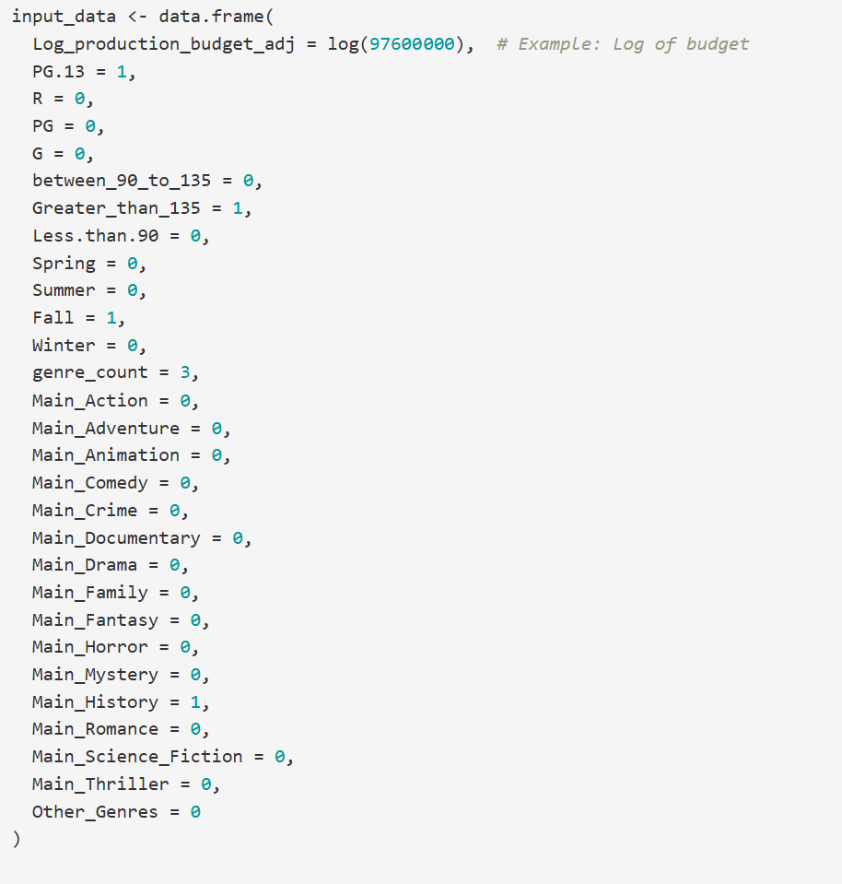
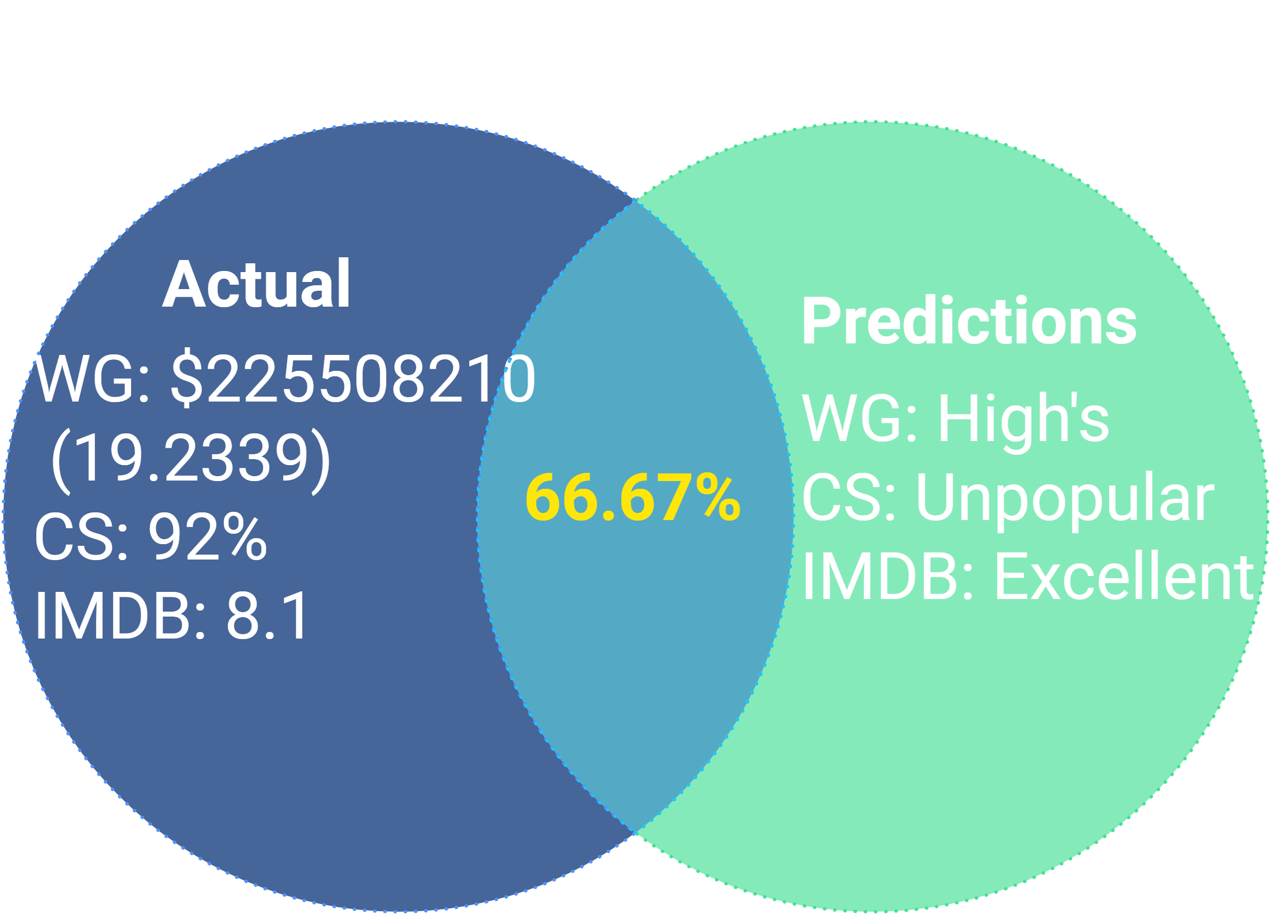
Example of 'Ford v Ferrari' (2019)

Slide 13
Proof Of Concept
Predictive Models Results |  |  |  |  | Camparision of Results
Scores | Percentage | Number of movies | Results Percentage |  | Variables | Gross Category | IMDb Ratings | Critics Scores | Average
3 | 100.00% | 12 | 19.67%
2 | 66.66% | 27 | 44.26% |  | Models | Xgboost | Random Forest | Xgboost
1 | 33.33% | 22 | 36.07% |  | Dataset Accuracy | 71.99% | 58.46% | 60.73% | 63.73%
Total |  | 61 | 100.00% |  | Predictive Power Ftdata | 78.69% | 40.98% | 65.57% | 61.75%
Gathered 61 ransom movies from 2019 to 2024

Slide 14

Recommendation
High-Budget Films:
Budget: $150–300M
Runtime: Between 90 to 135 min, Greater than 135 min
Genres: Action, Adventure, Sci-Fi, Animation, Fantasy
Release Timing: Summer/Fall
MPAA Rating: PG / PG-13
Mid-Budget Films:
Budget: $50–150M
Runtime: Between 90 to 135 min
Genres: Drama, Historical, Thriller, Biographical, Mystery
Release Timing: Fall/Winter
MPAA Rating: PG-13 / R
Low-Budget Films:
Budget: <$50M
Runtime: Less than 90 min and Between 90 to 135
Genres: Horror, Thriller, Comedy, Drama
Release Timing: Spring/Fall
MPAA Rating: R

Slide 15
Thank you

Slide 16
Appendix

Slide 17
Literature Review Overview
Ensemble Machine Learning Approaches:
- Gupta et al. (2022): Highlights the role of ratings, release month, multi-genre appeal, and duration.
Regression Models and Predictors:
- Yoo, Kanter, and Cummings (2011): Identified budget and audience size as success
indicators.
Influential Studies:
- Dalton & Leung (2019): Role of critic reviews and random forests achieving R-squared
of 0.83.
- Sharma et al. (2020): Random Forest and XGBoost models with R-squared values of
0.85 and 0.87.
- Hagen & Jøsok (2021): Seasonality and timing as significant predictors.

Slide 18
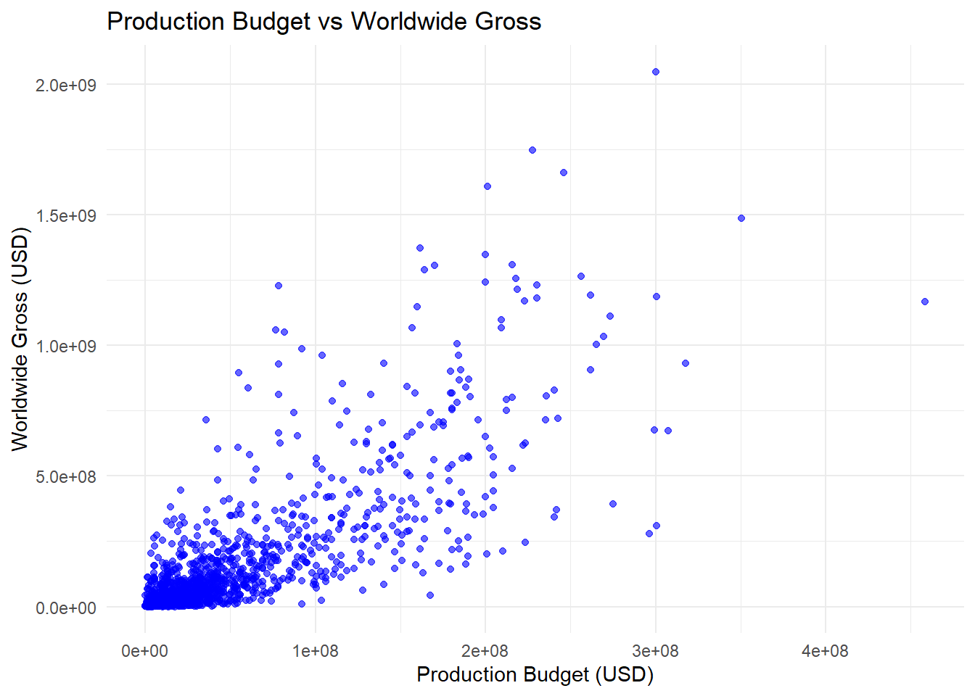

Slide 19
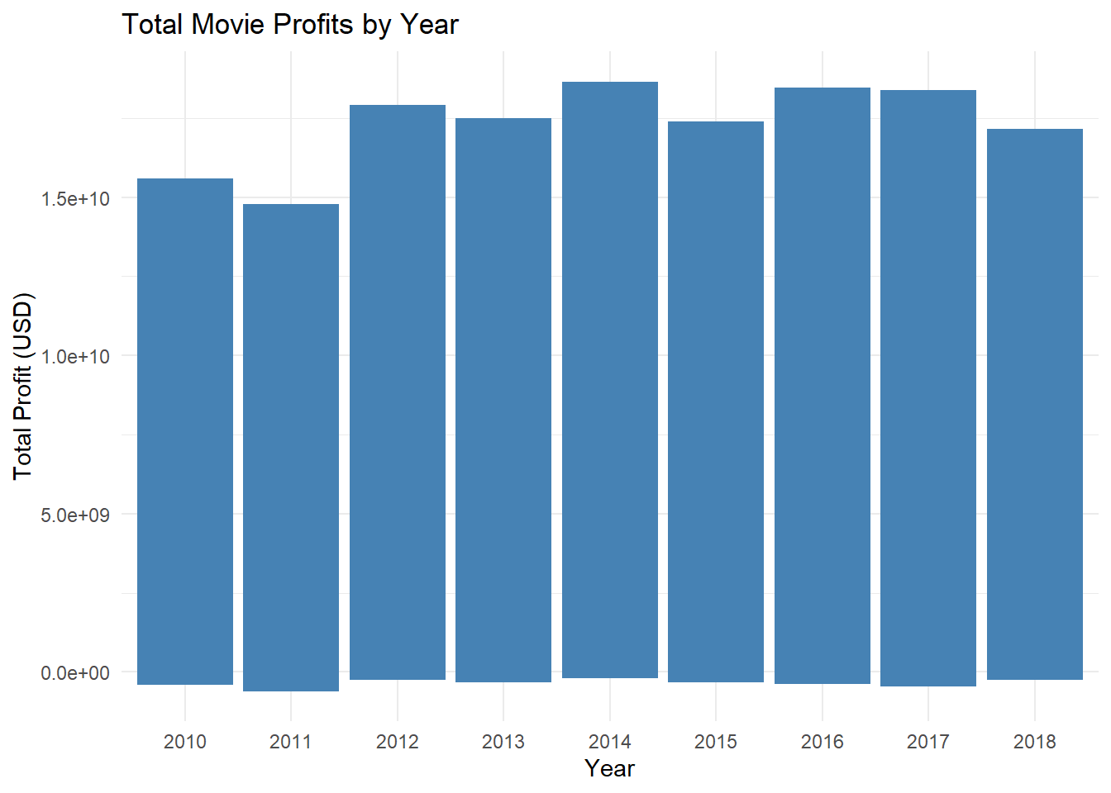

Slide 20
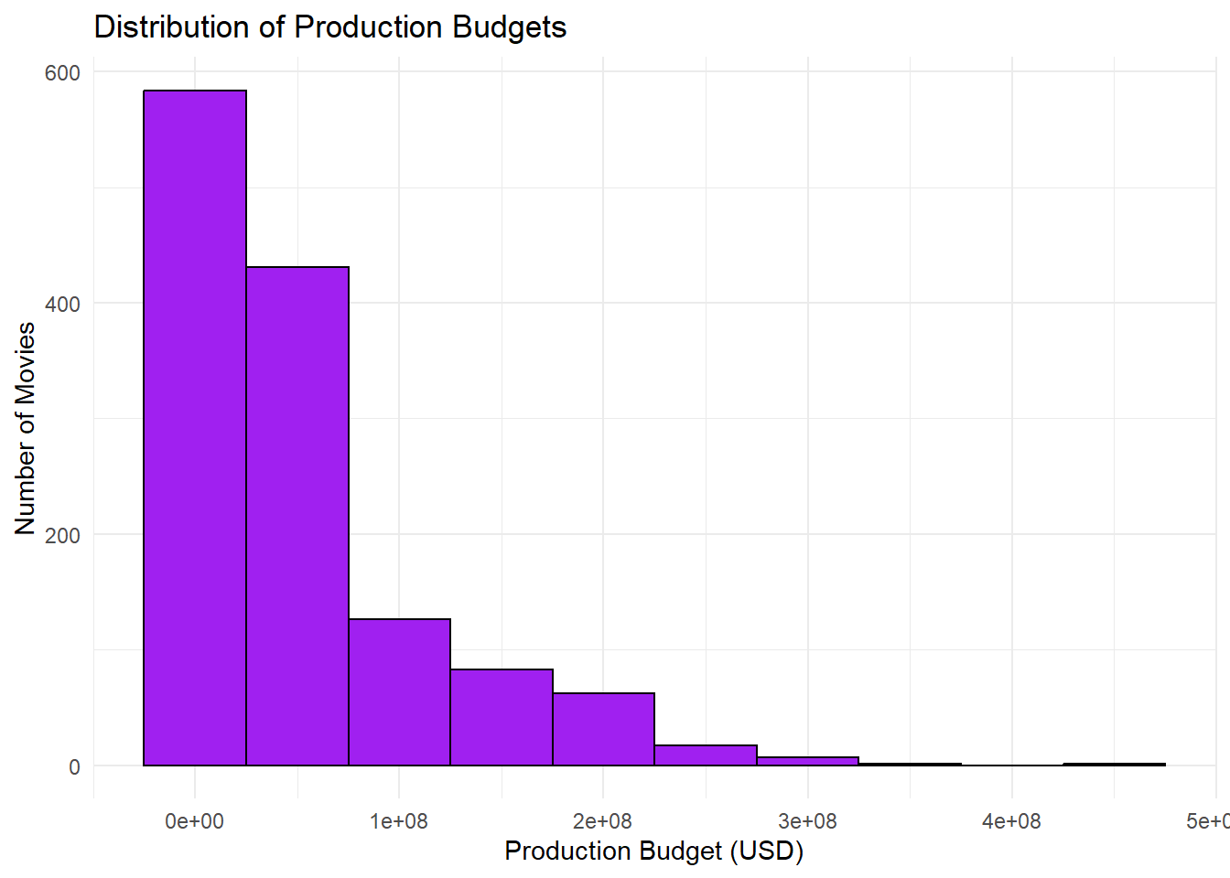

Slide 21
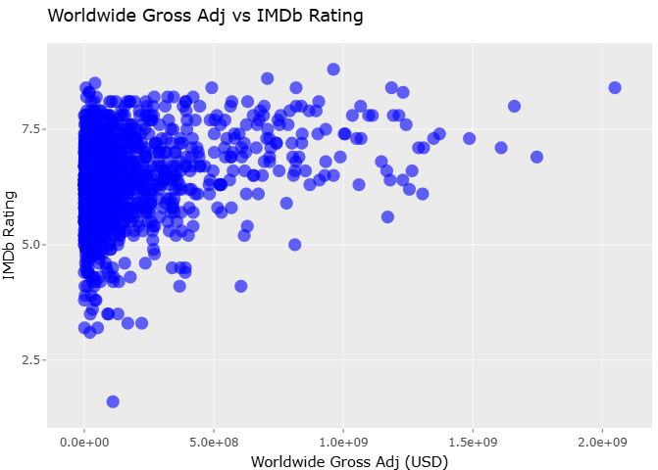

Slide 22
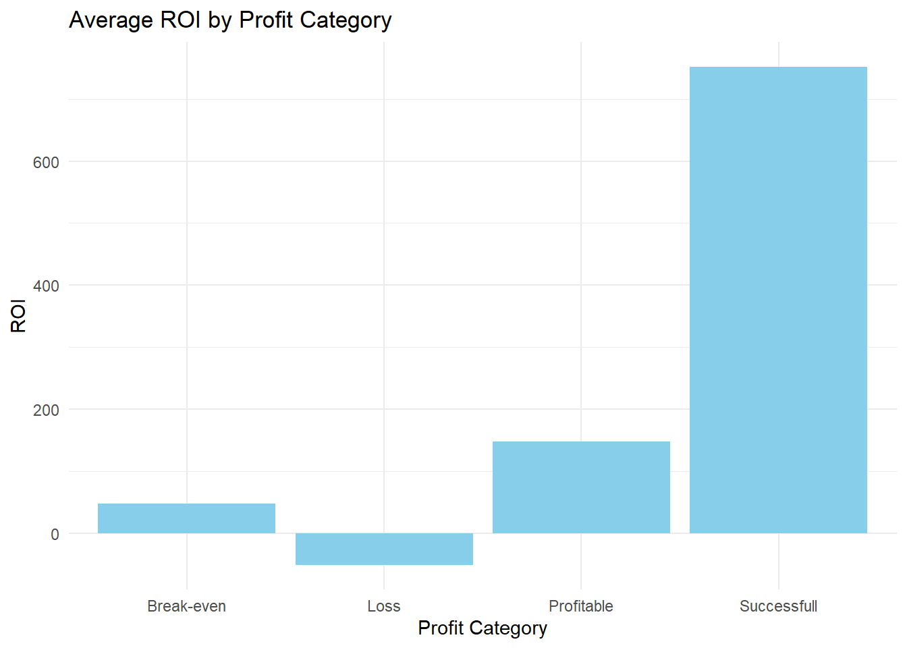

Slide 23
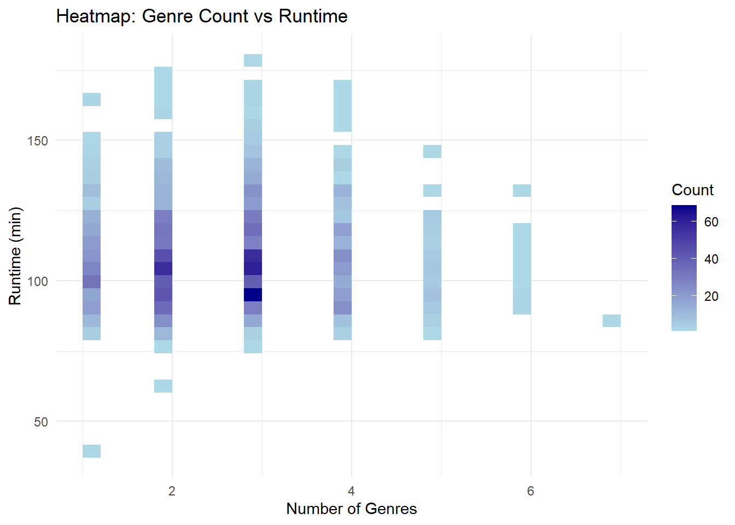

Slide 24
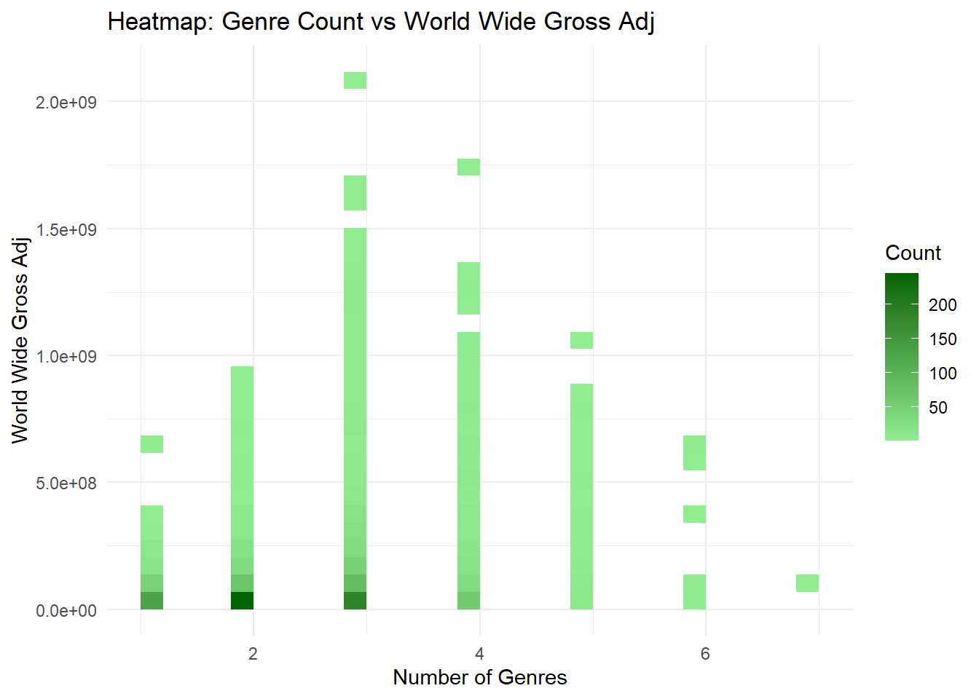

Slide 25
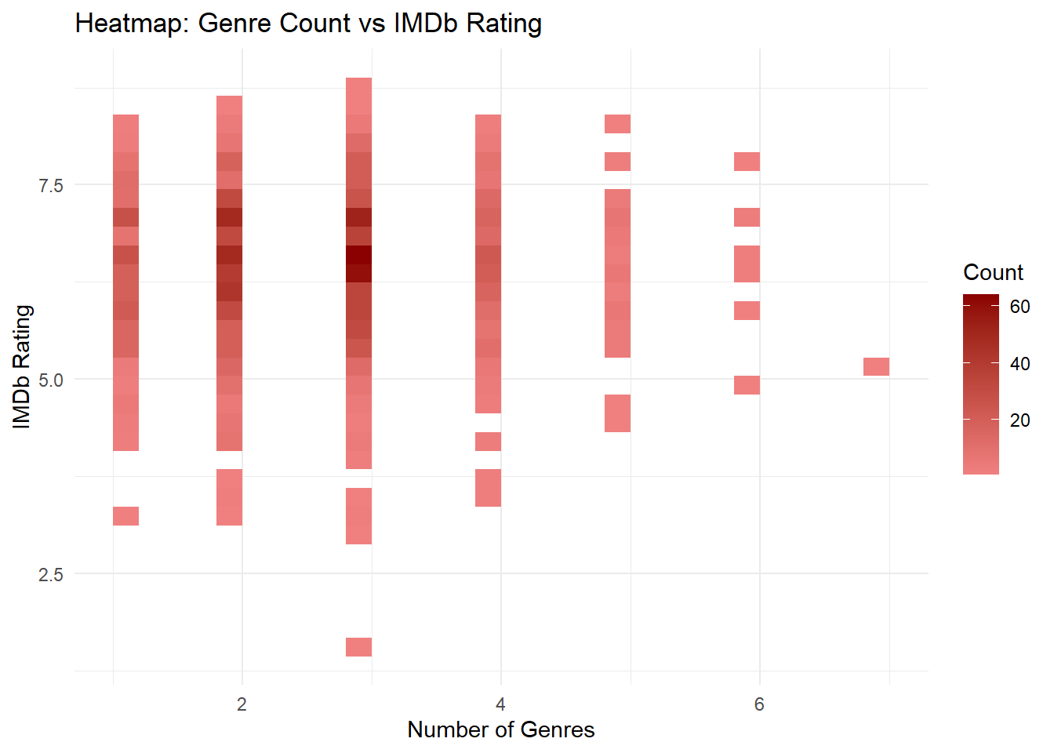

Slide 26
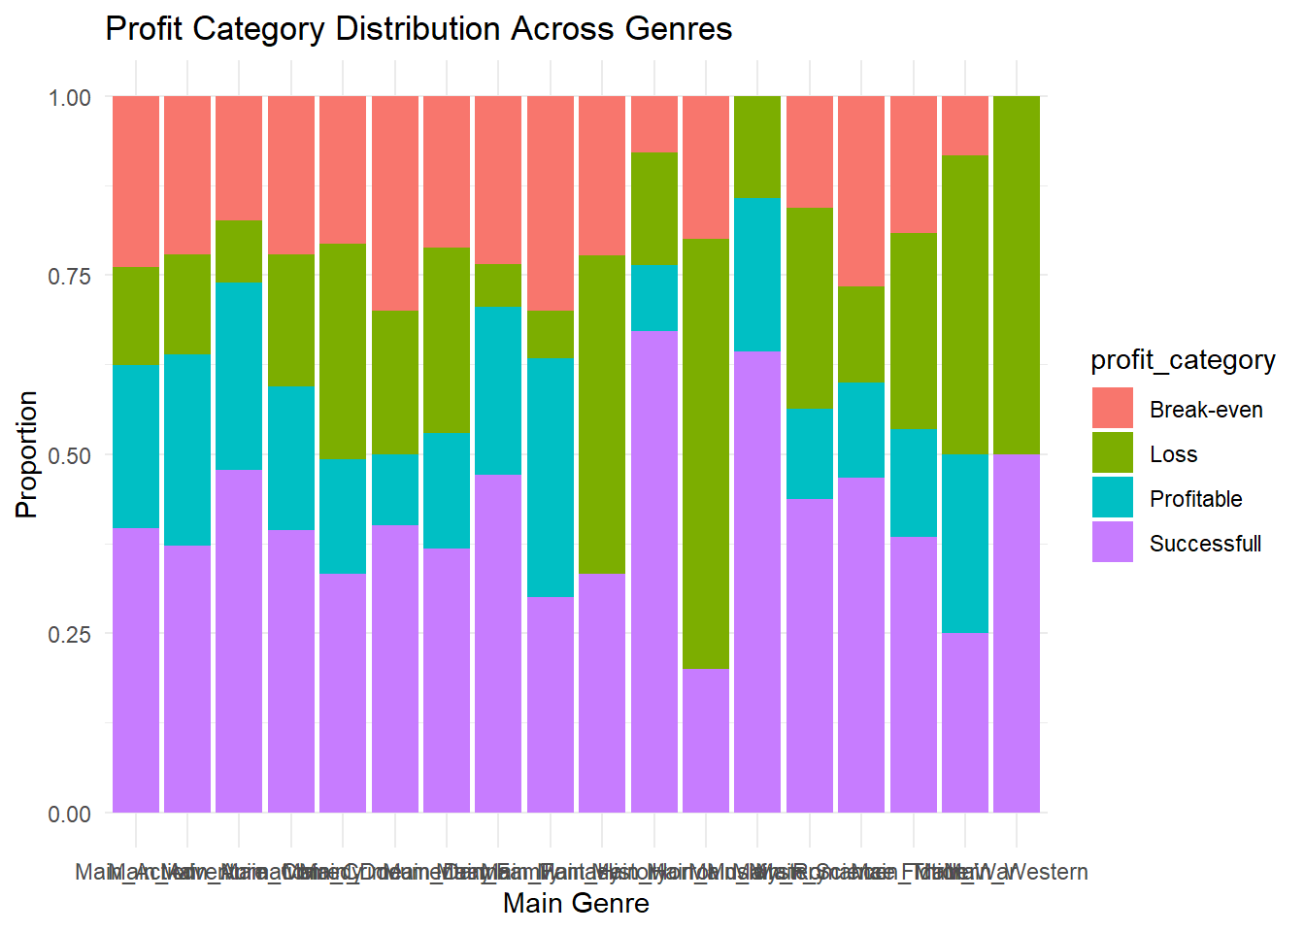

Slide 27
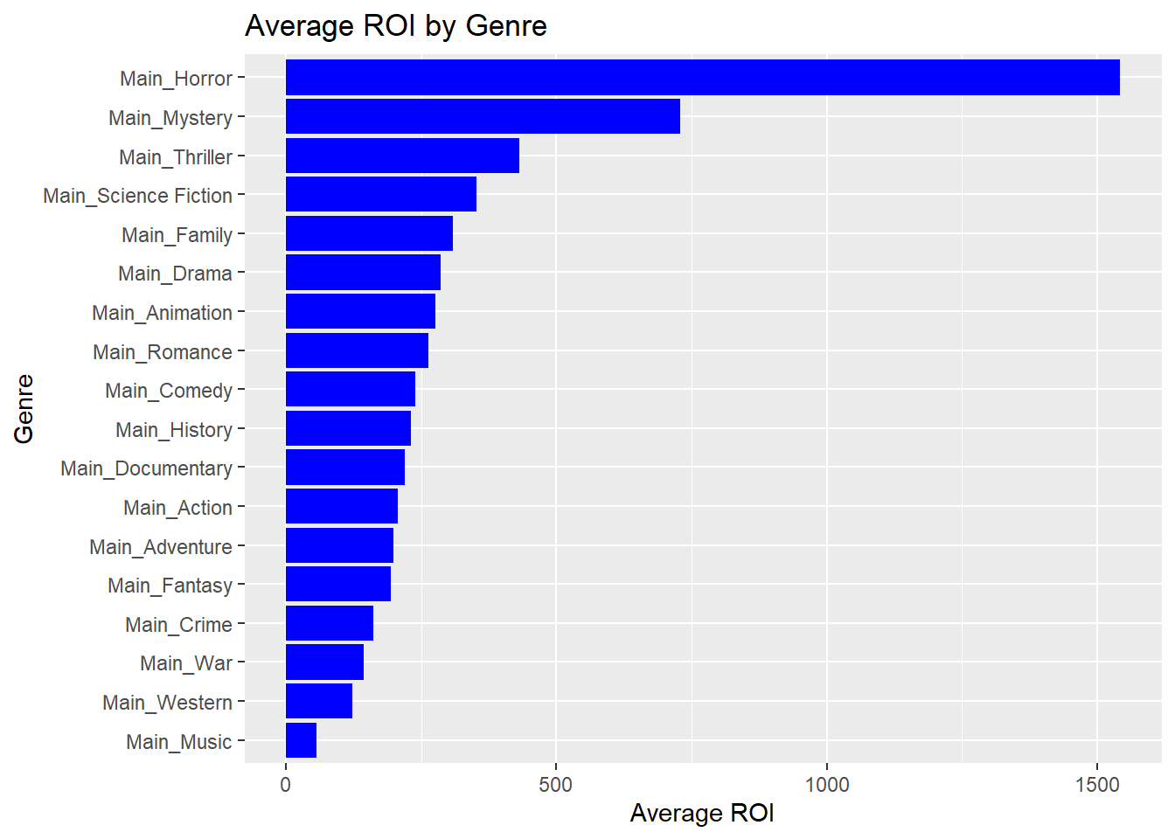

Slide 28
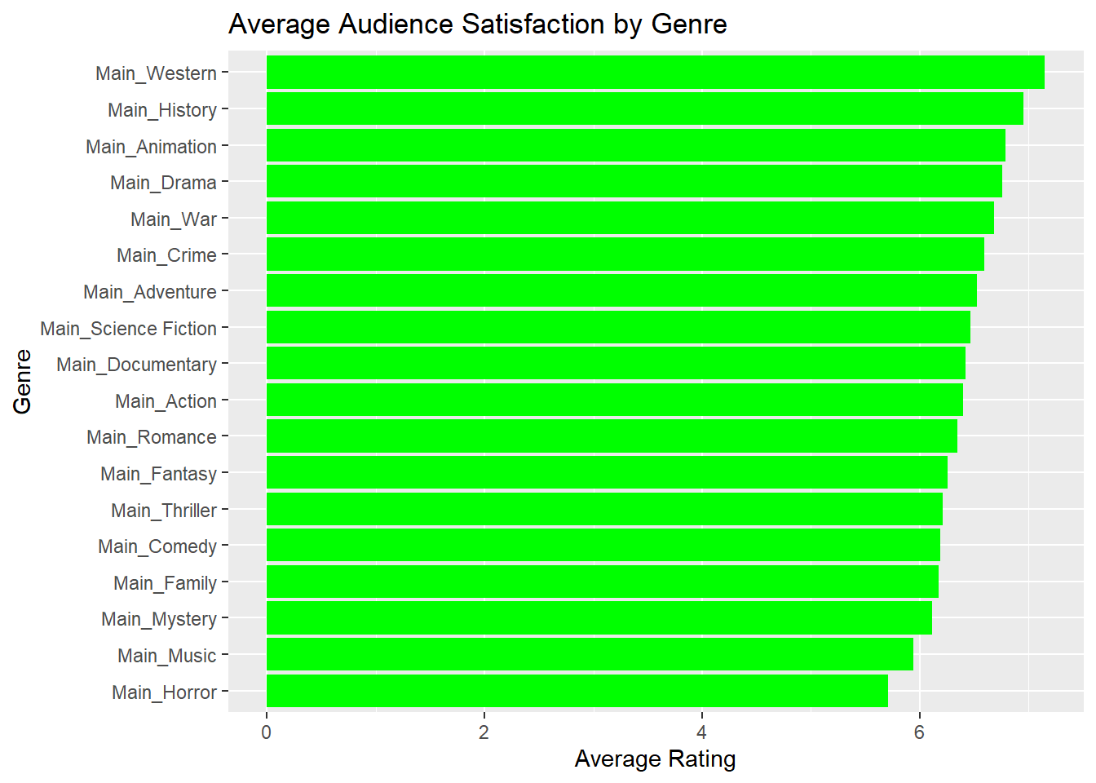

Slide 29
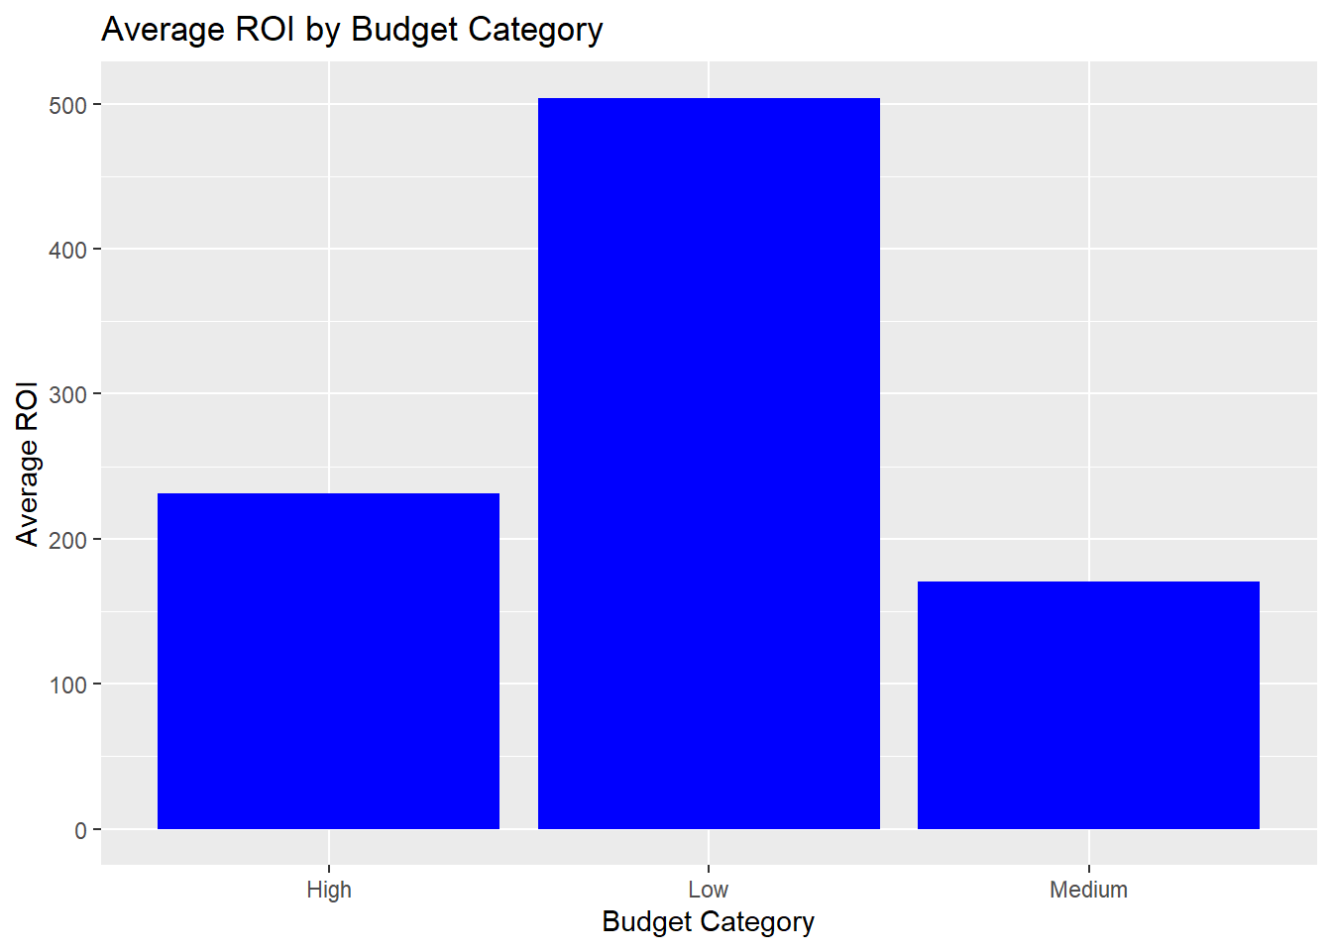

Slide 30
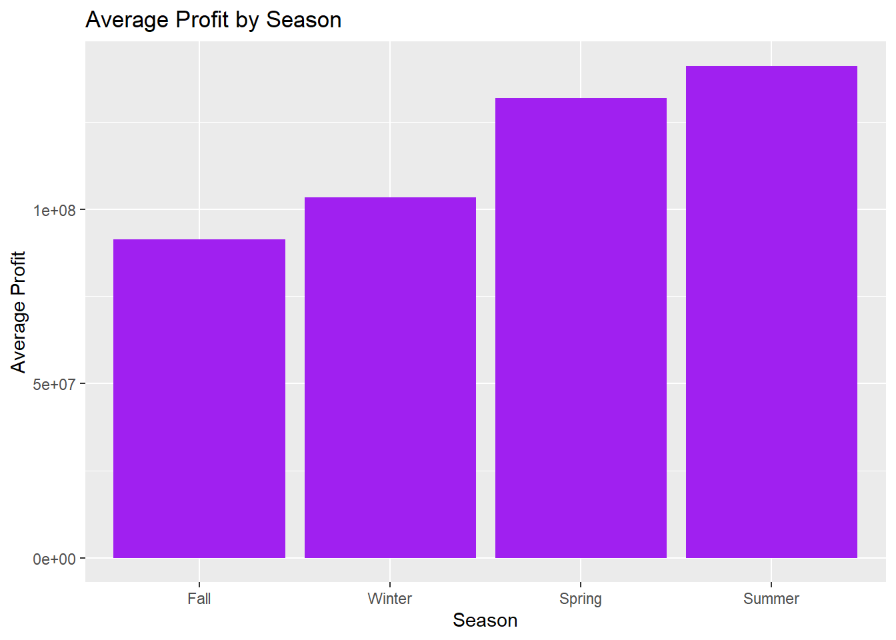

Slide 31
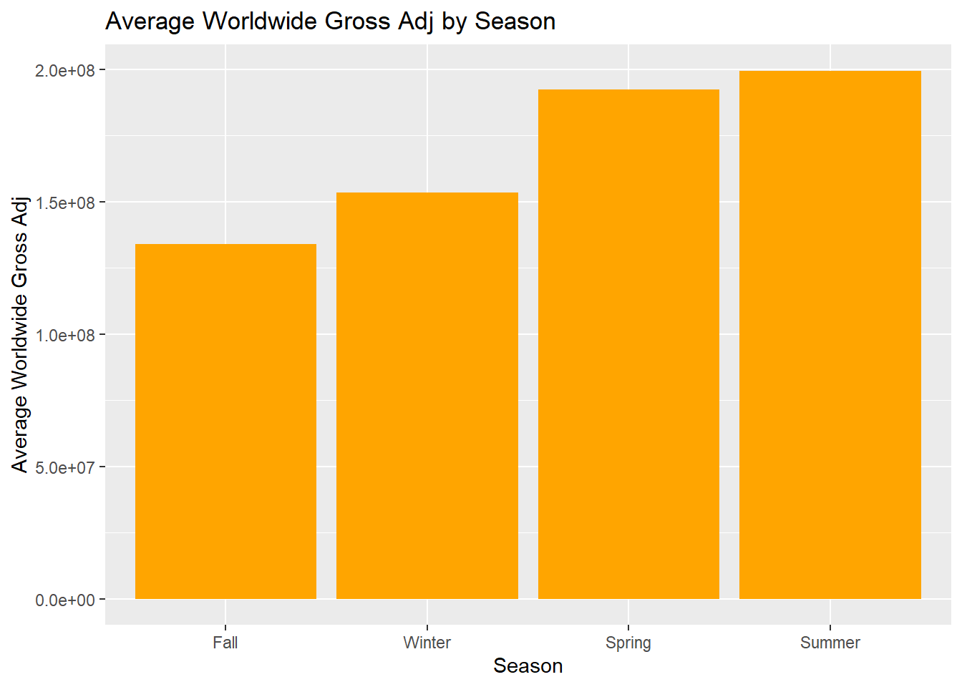

Slide 32
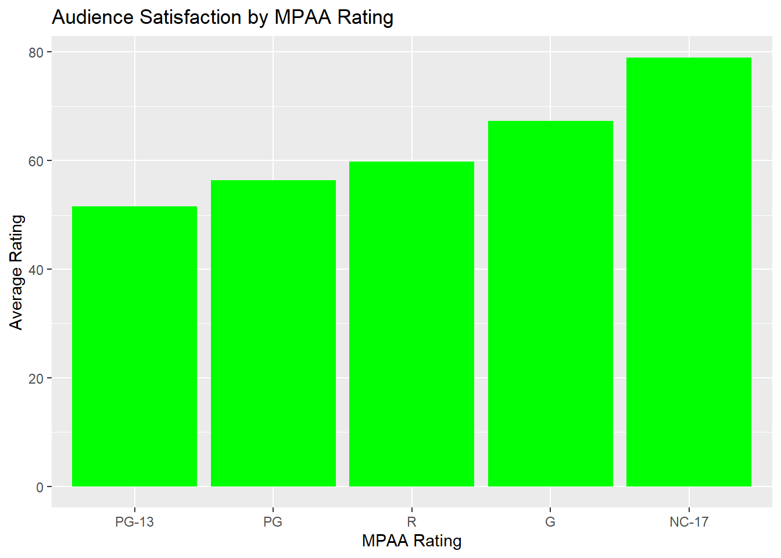

Slide 33
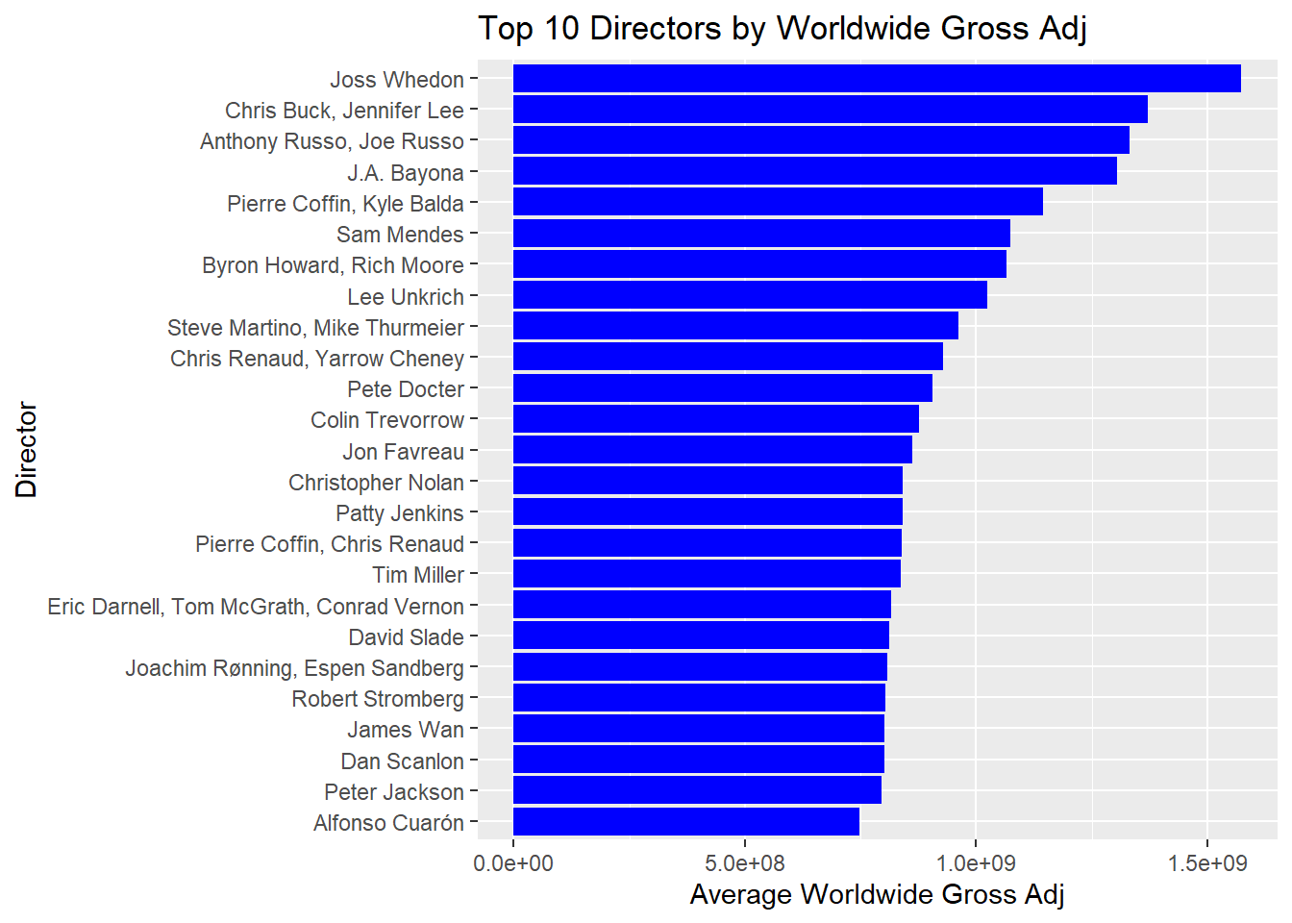

Slide 34
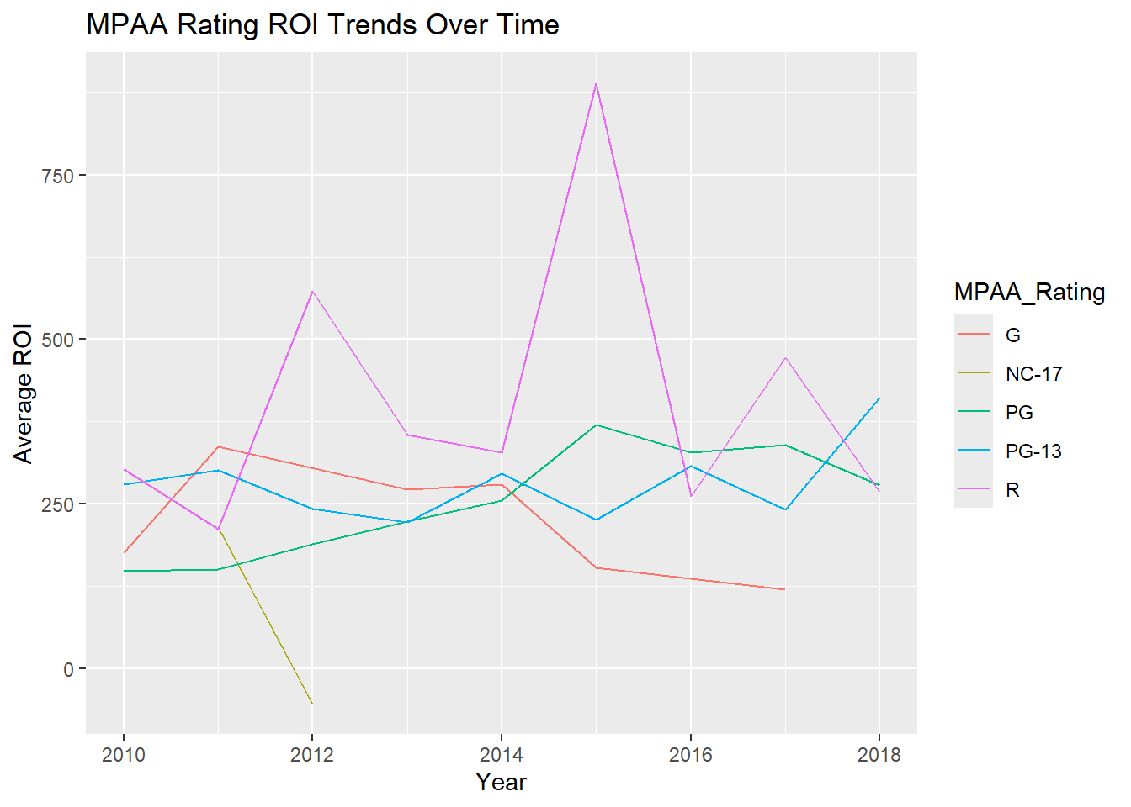

Slide 35
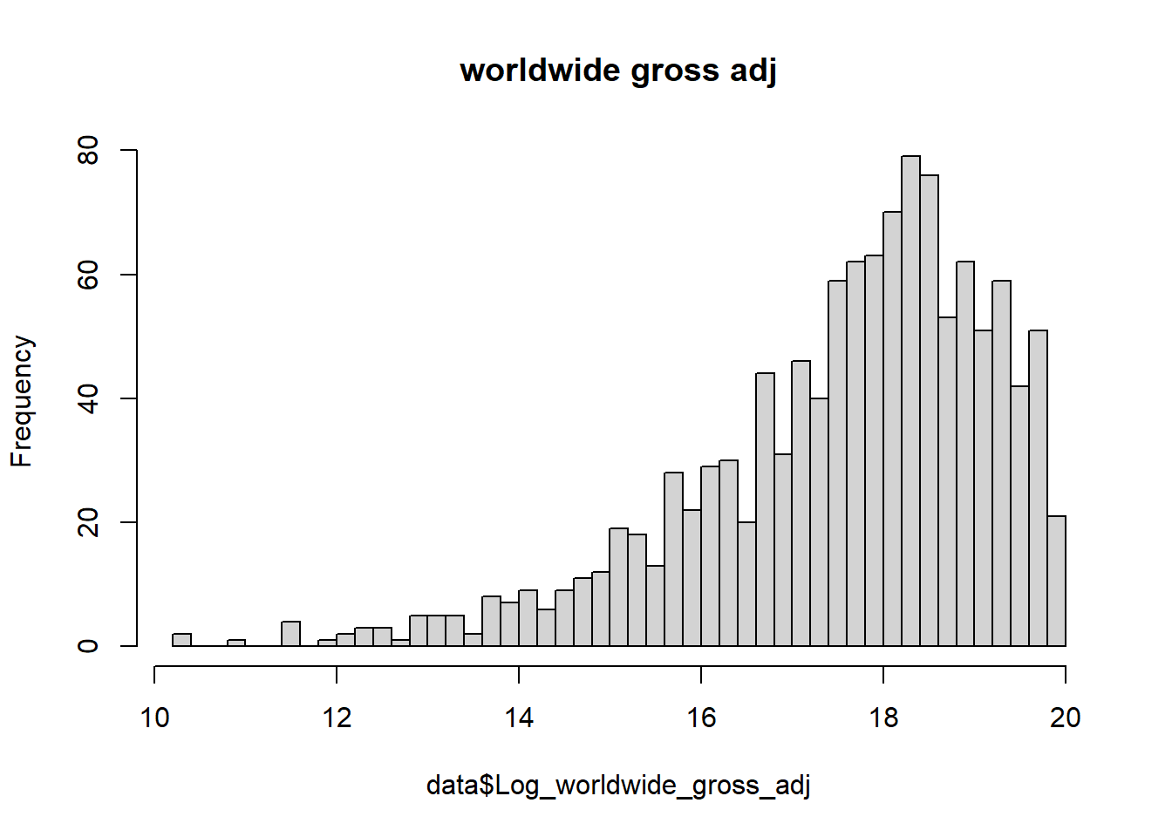
Before doing log transformation

Slide 36
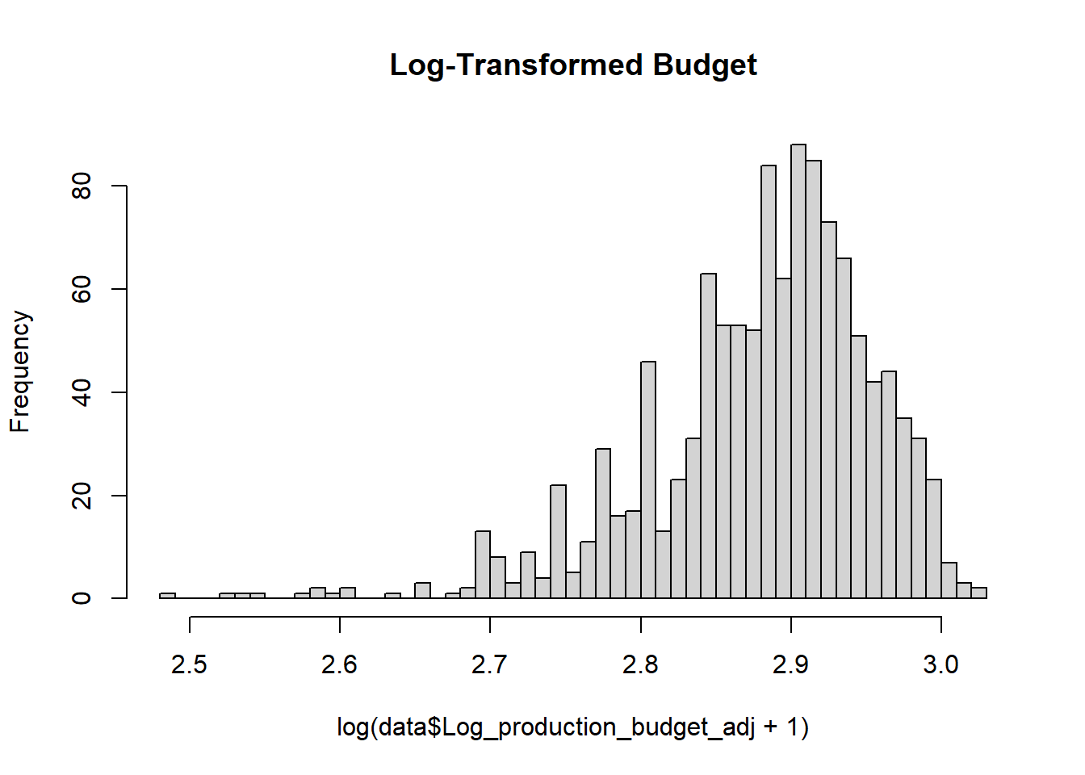
After doing log transformation

Slide 37
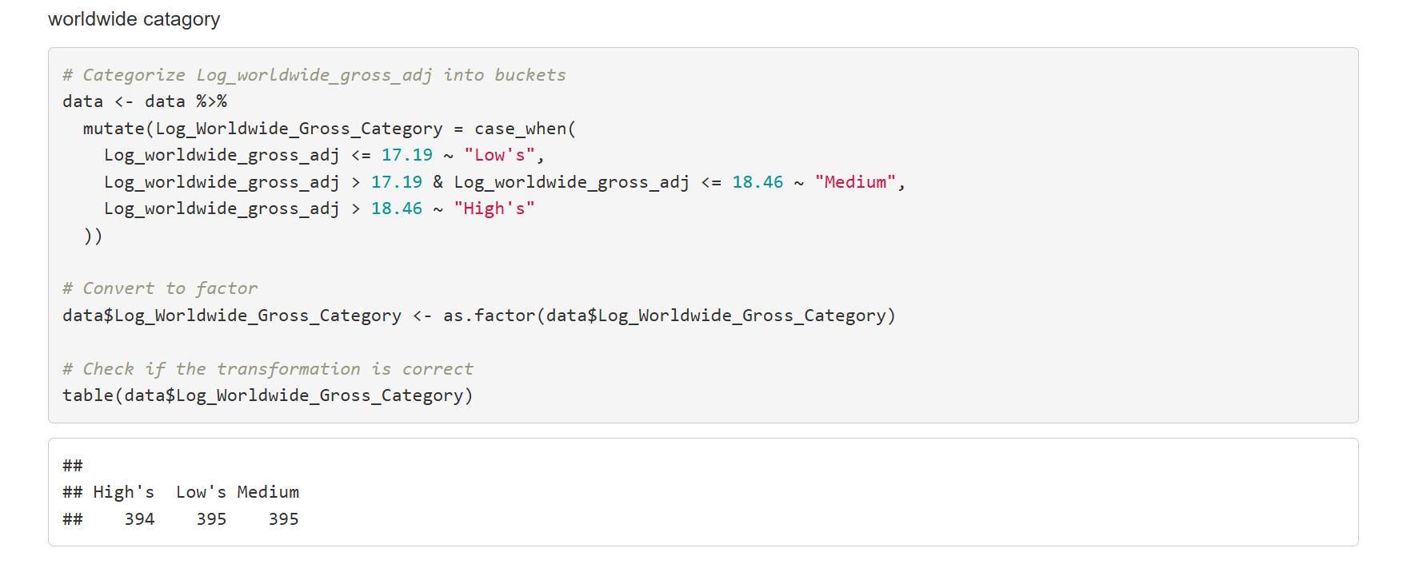

Slide 38
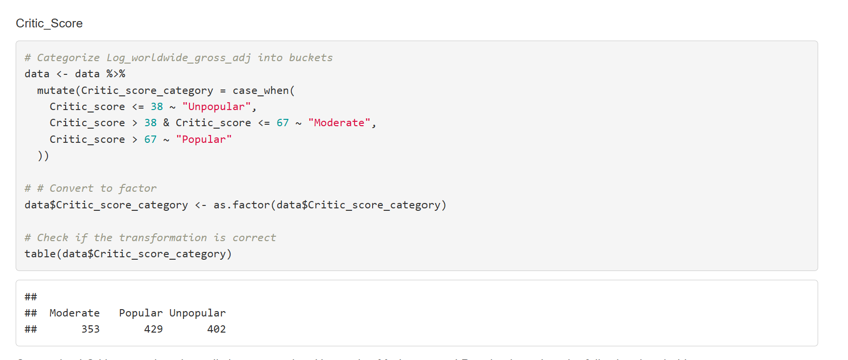

Slide 39
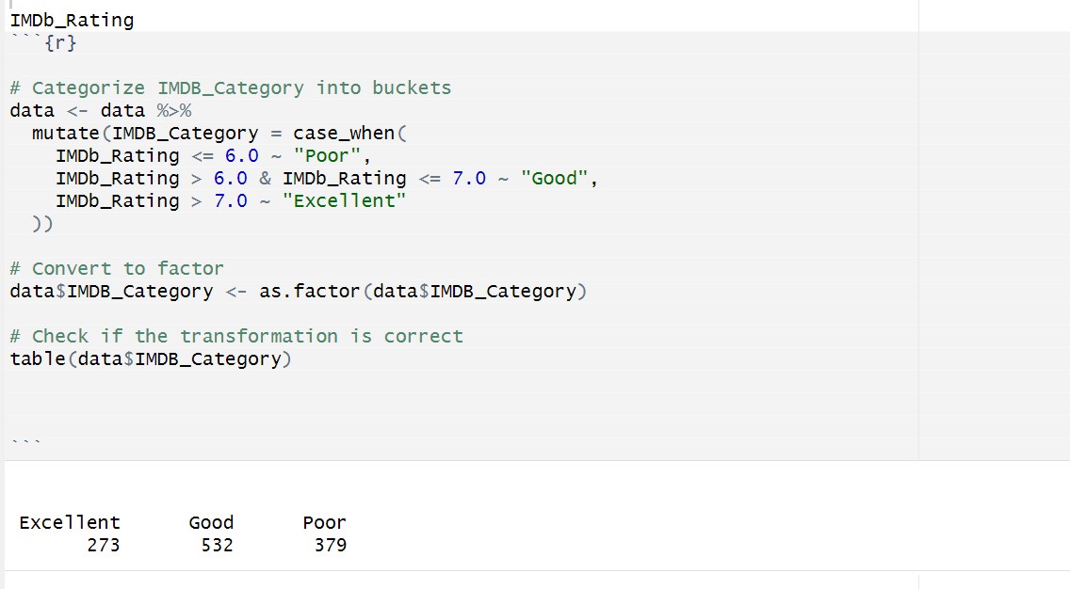

Slide 40
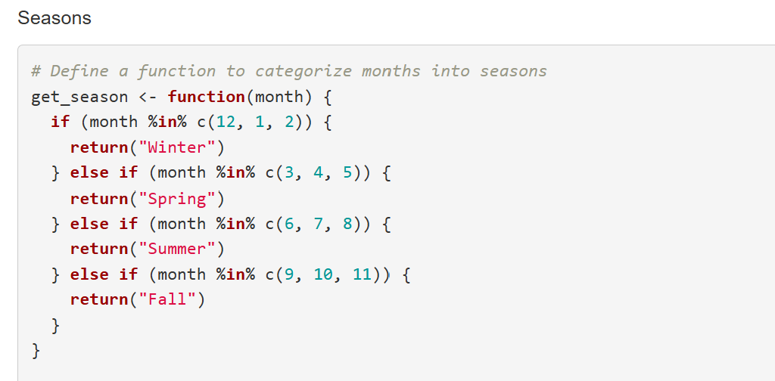

Slide 41
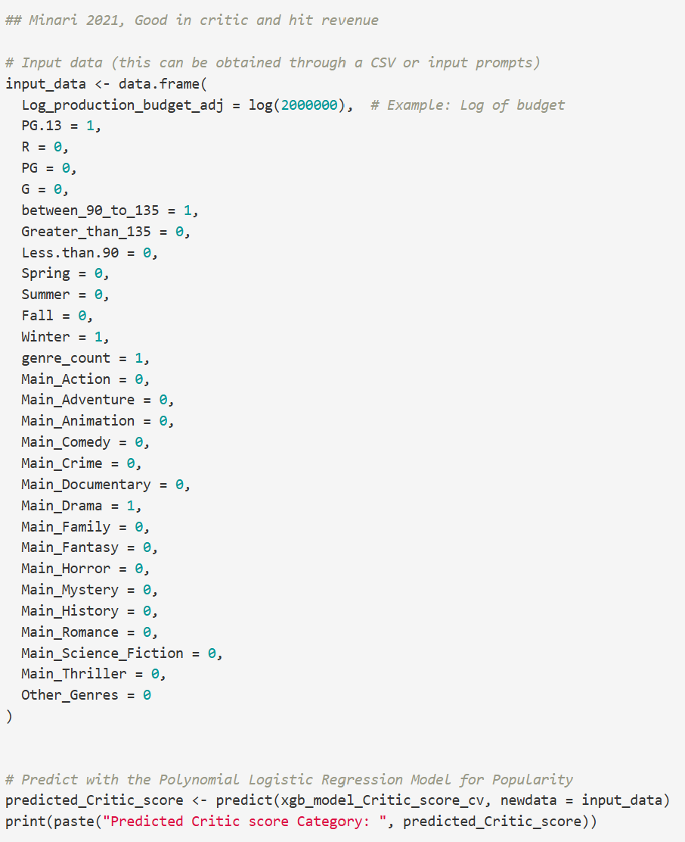
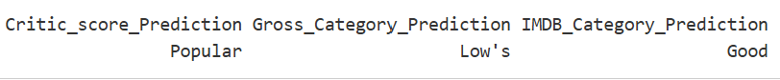
This is what code looks like
This is what results looks like

Slide 42
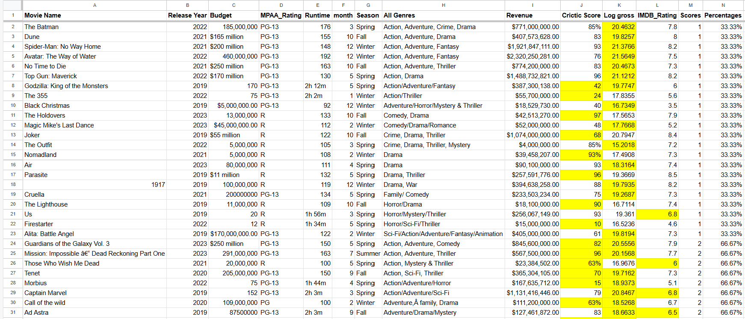
The Calculation we did. Page 1

Slide 43
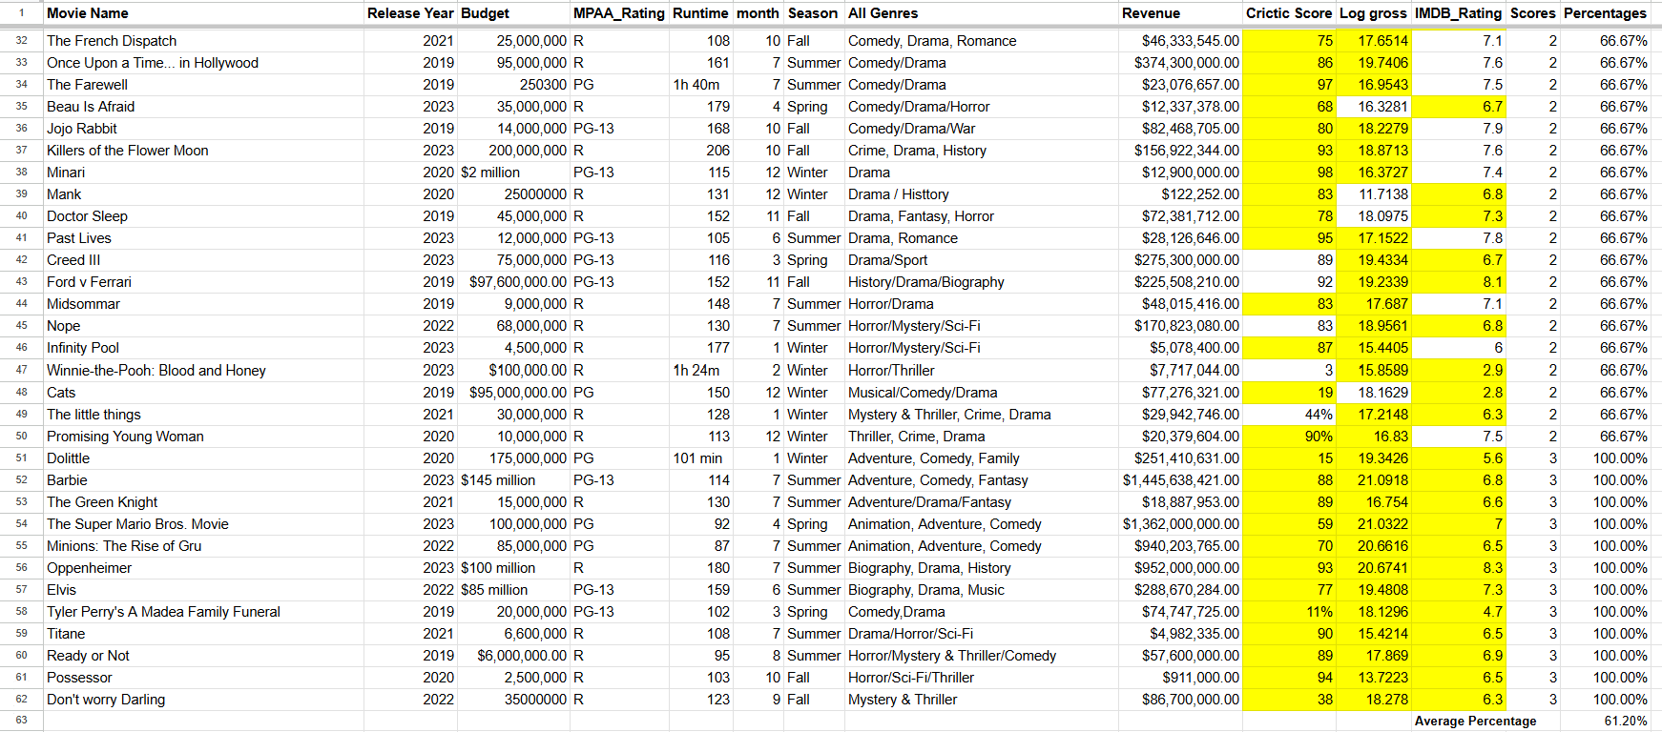
The Calculation we did. Page 2

